Slide 1
Lecture 31 (2) – Introduction to Dynamic Programming
CST370 – Design & Analysis of Algorithms
Dr. Byun
Computer Science

Slide 2
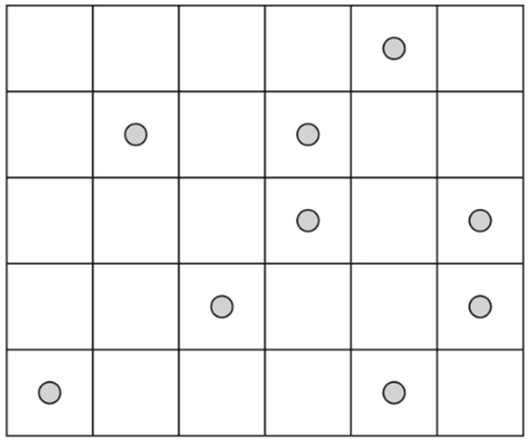
Coin-Collecting Problem

Slide 3
Recurrence Relation for Coin-Collecting Problem
Let F(i, j) be the largest number of coins you can collect at the location (i, j).
F(0, j) = 0
F(i, 0) = 0

Slide 4
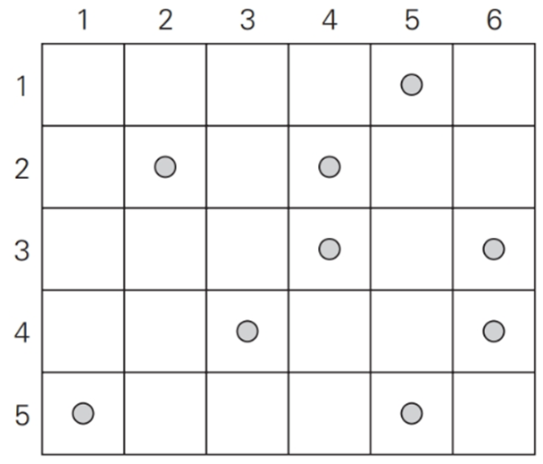
Recurrence Relation for Coin-Collecting Problem
F(i, j) = max{F(i-1, j), F(i, j-1)} + c_{i,j}
where c_{i,j} = 1 if there is a coin in the cell(i, j).

Slide 5

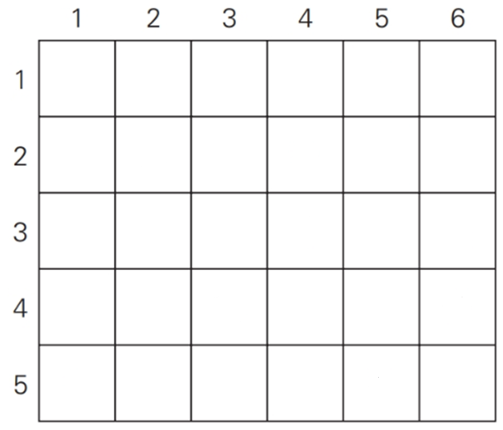
Example (1 of 2)

Slide 6
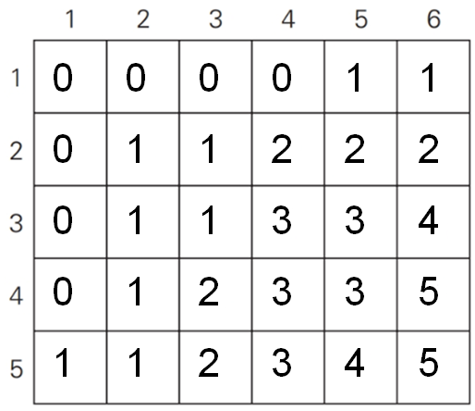
Example (2 of 2)
How to find the optimal path?

Slide 7
Analysis

Slide 8
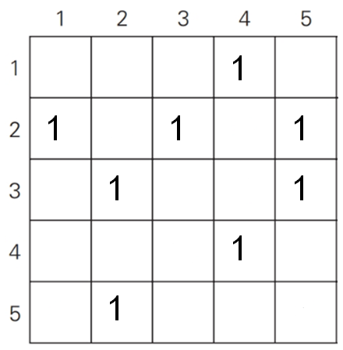
Exercise (1 of 2)

Slide 9
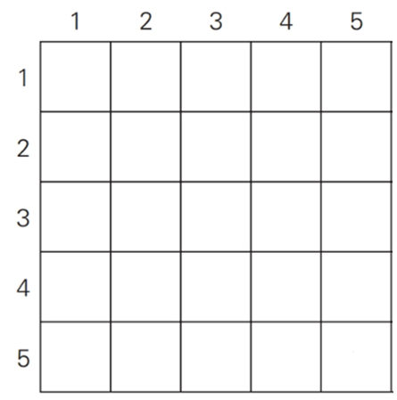
Exercise (2 of 2)

Slide 10
Summary: Divide-and-Conquer vs.
Dynamic Programming
Common idea
  Divide a problem’s instance into smaller instances of the same problem.
Difference
  Divide-and-conquer: No intersection (= overlapping) among small instances.
  Dynamic programming: Overlapped small instances and we need a table to store sub-solutions.

Slide 11
Puzzle
Assume that you construct a max-heap with five nodes 10, 20, 30, 40, and 50.
  Present all possible heaps with the five numbers that satisfy the requirement of a max-heap.

Slide 12
Solution

